Slide 1

Powerlifter Deadlift Regression Analysis
a Python Data Science project by Andrew Dettor

Slide 2
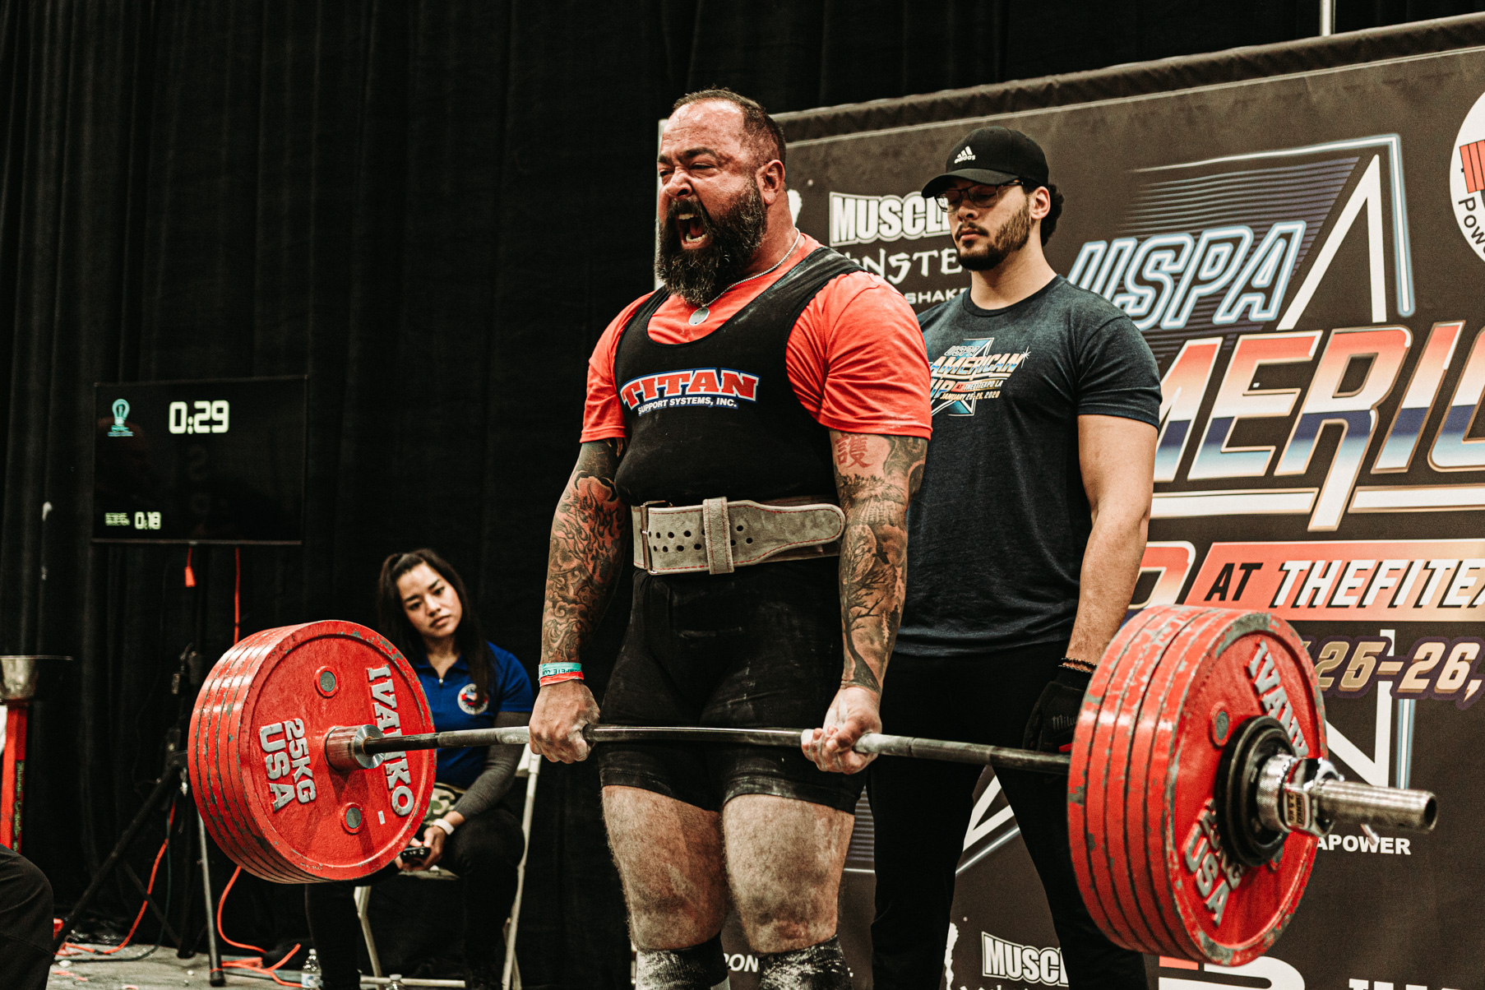
Problem
How well can you estimate a powerlifter’s deadlift performance?
1 rep max
3 attempts
Squat, bench, deadlift
Scope out competition ahead of time

Slide 3
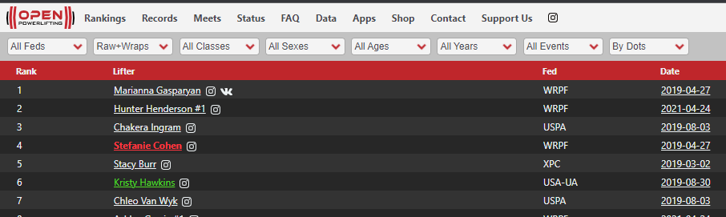
Dataset
openpowerlifting.org
1423354 samples
37 variables

Slide 4
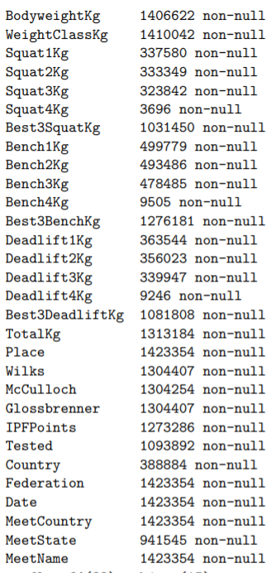
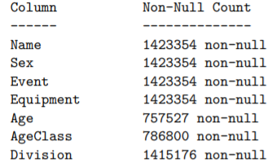
Features
As you would expect
Age, sex, event, equipment used, division, bodyweight, federation, country of origin, etc
Attempts for all three lifts (SBD)

Slide 5
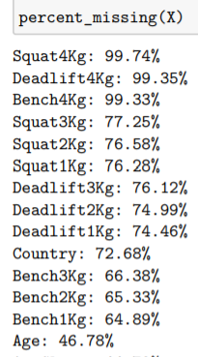
Data Cleaning
Missing values
Many had >60% missing
Need to impute somehow
Drop columns
Target leakage
Drop rows
Event had all 3 lifts
Successful in all 3 lifts
~800,000 samples left

Slide 6
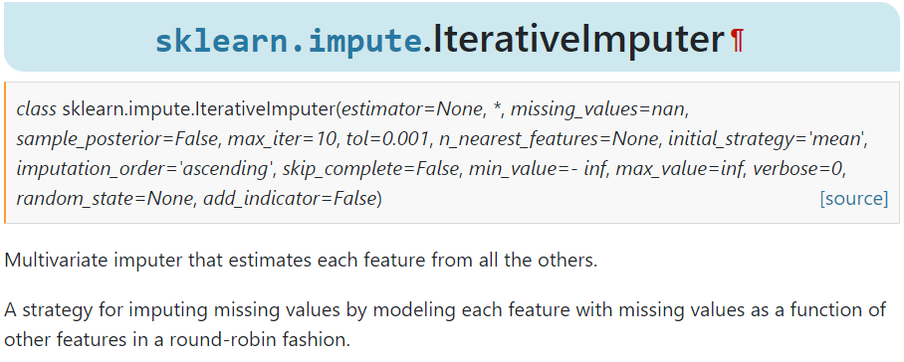
Missing Value Imputation
Categorical
Fill with “missing”
Country, division, meetstate, tested, sex, equipment
Numerical
Iterative Imputer
Age, bodyweight

Slide 7
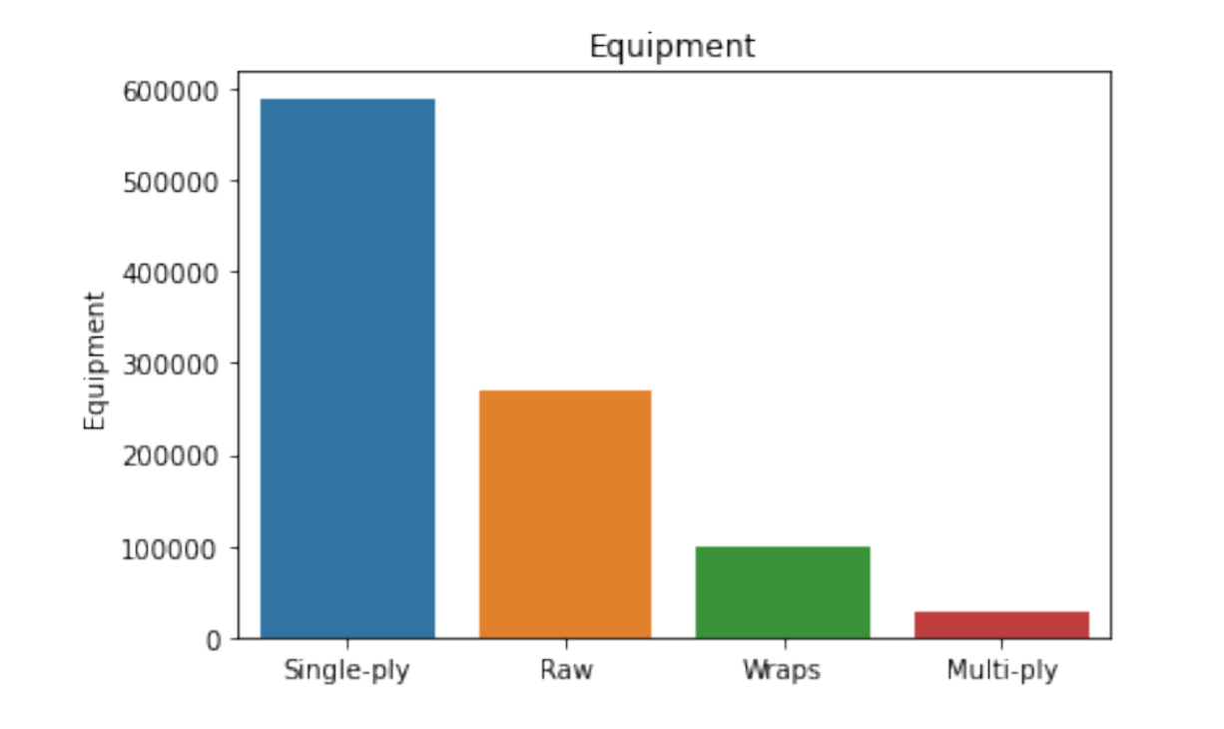
Exploratory Data Analysis (EDA)
Want to find interesting trends and connections
Numerical
Correlations
Histograms
Line plots
Categorical
Barplots
Boxplots
Pivot tables

Slide 8
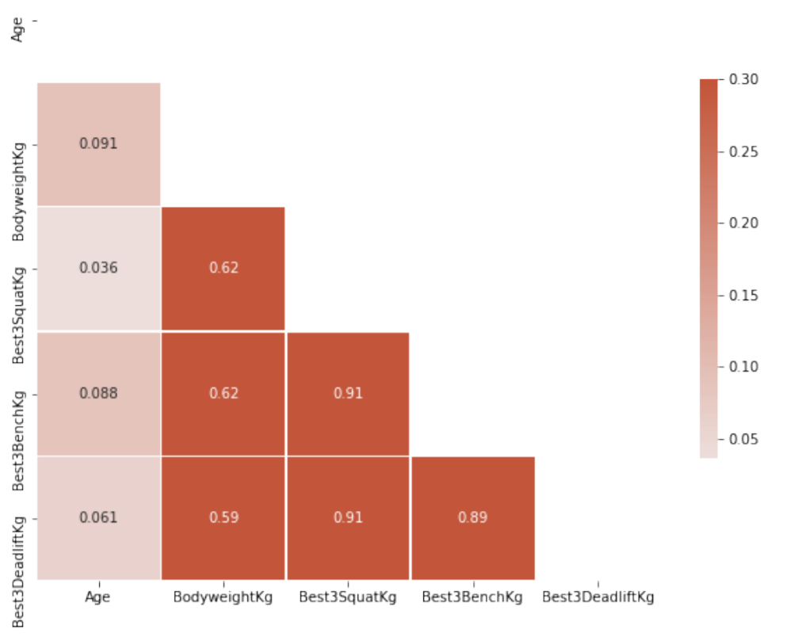
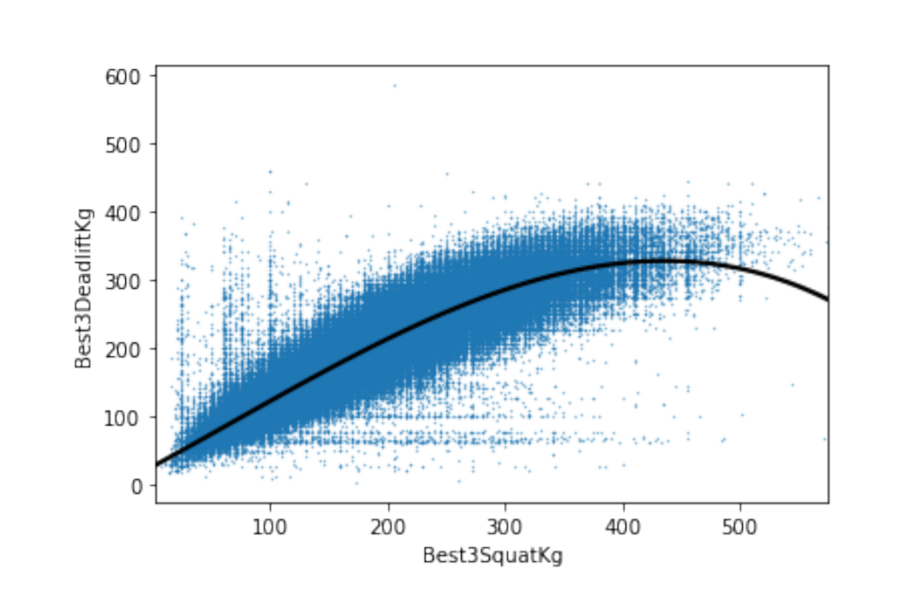
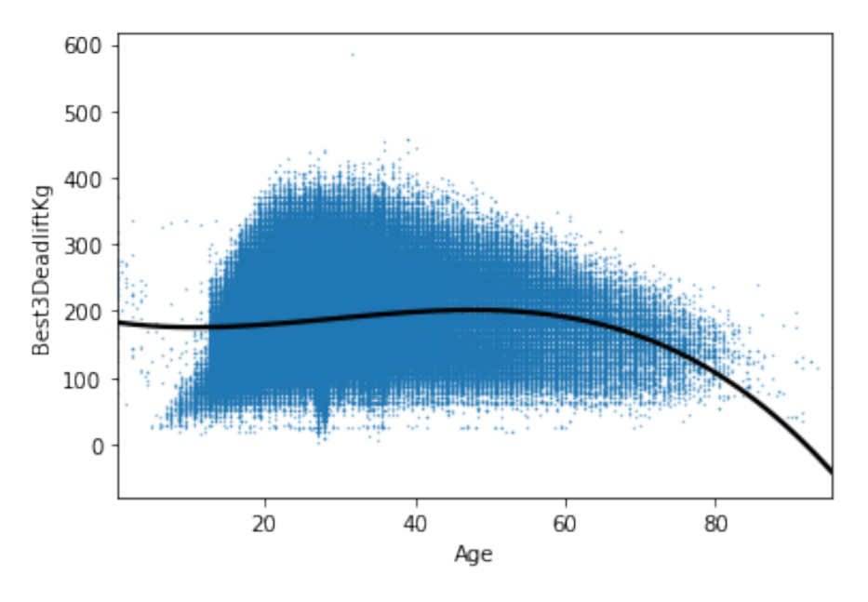
EDA - Numerical
Correlations with body weight, best squat, and best deadlift
No surprise

Slide 9
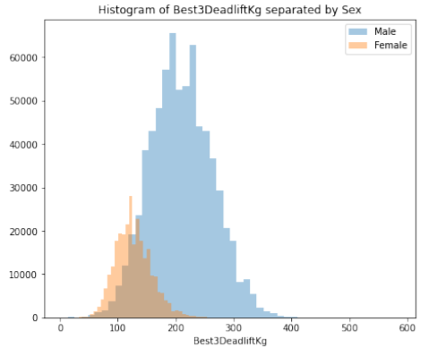
EDA - Numerical
Sex differences
Also not surprising
Ratio

Slide 10
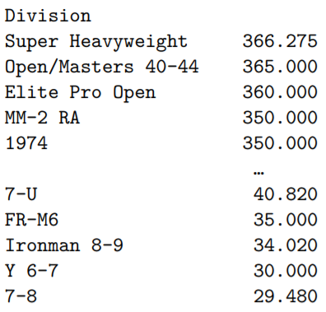
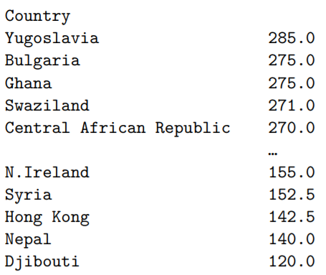
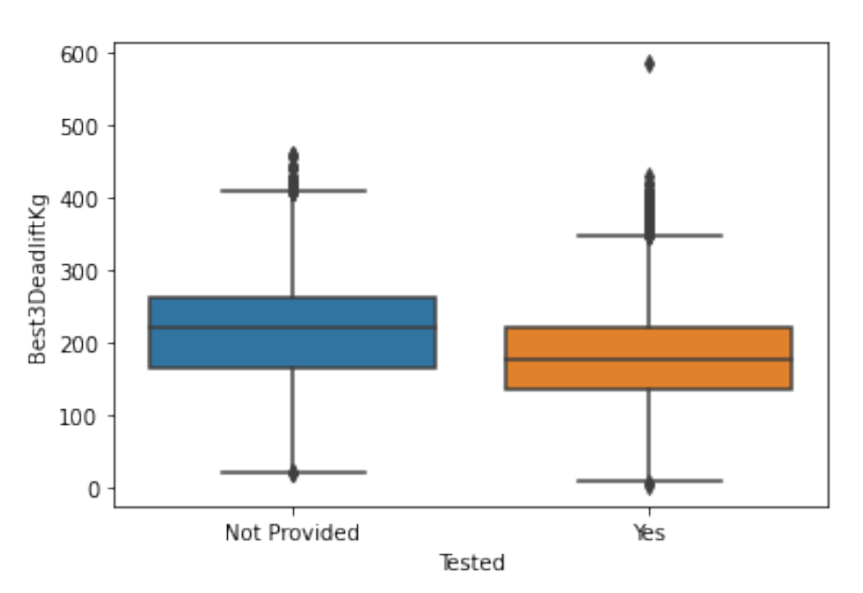
EDA - Categorical
Performance enhancing drugs?
Divisions?
Country of origin?
Pivot Tables (average 1RM Deadlift for each categorical value)

Slide 11
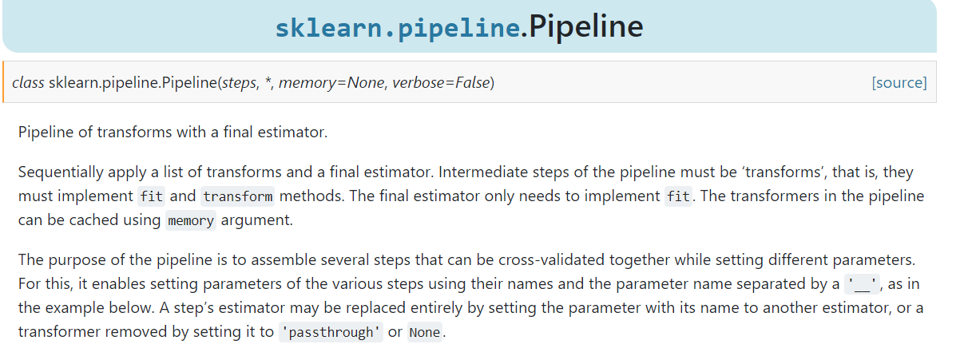
Modelling - Plan
Feature engineering
Categorical encoding
Preprocessing pipeline
Model training
Hyperparameter optimization
Feature selection
Interpretation

Slide 12
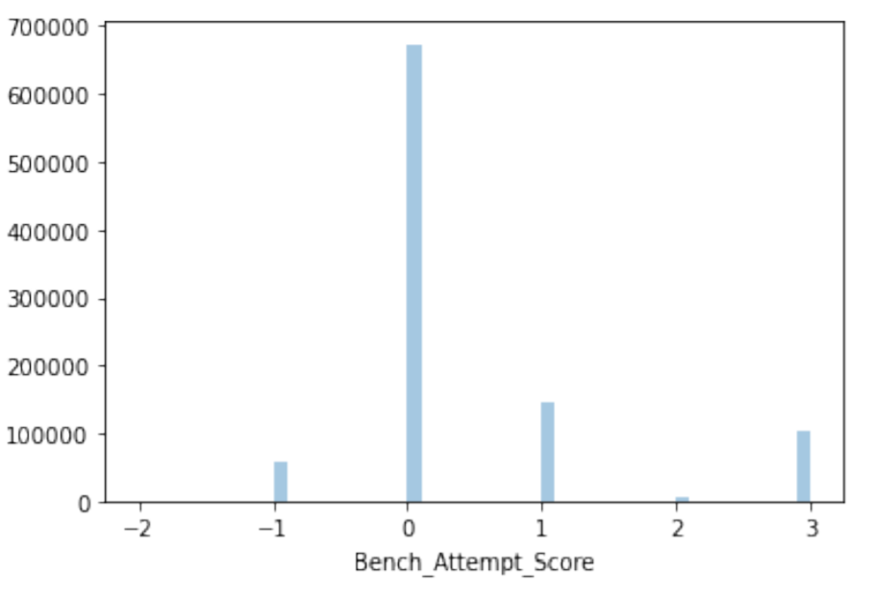
Feature Engineering
Count fails and successes for each lift
+1 for success, -1 for fail, 0 for unknown
6 features -> 3 features

Slide 13
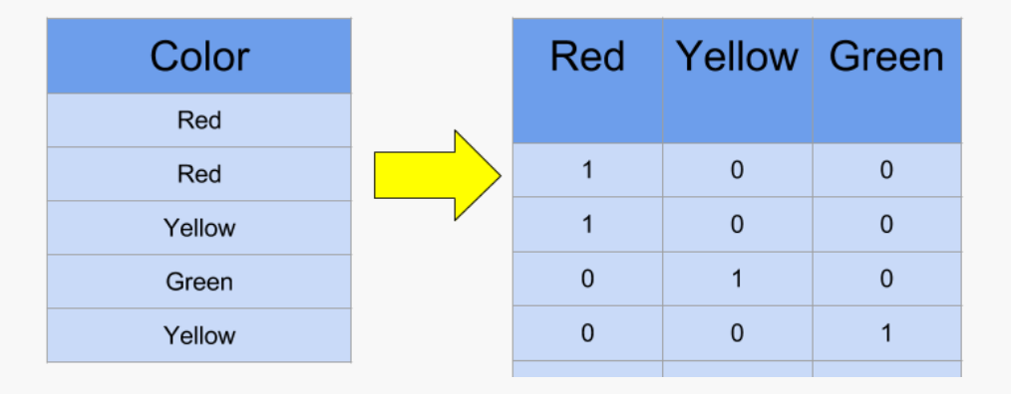
Categorical Encoding
Target Encoding
High cardinality
No target leakage
One-Hot Encoding
Low cardinality

Slide 14
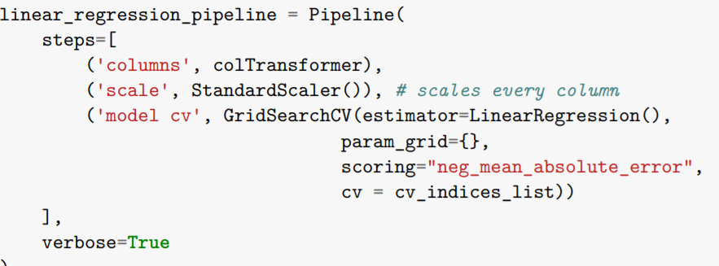
Data Pipeline
Scikit-learn API
Custom Column Transformer
preprocessing
Estimator
model
Cross-validation
GroupShuffleSplit on Name
5 splits

Slide 15
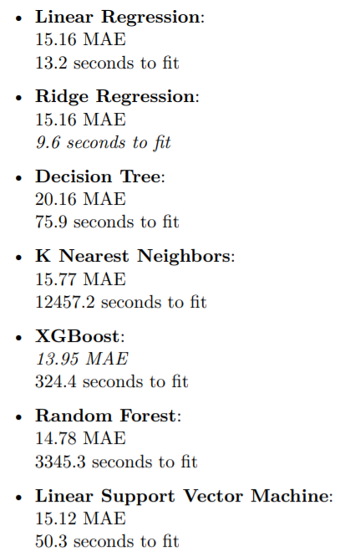
Modelling
Performance
Best - XGBoost
Worst - Decision Tree
Fit Time
Best - Ridge Regression
Worst - Random Forest
Linear models do very well

Slide 16
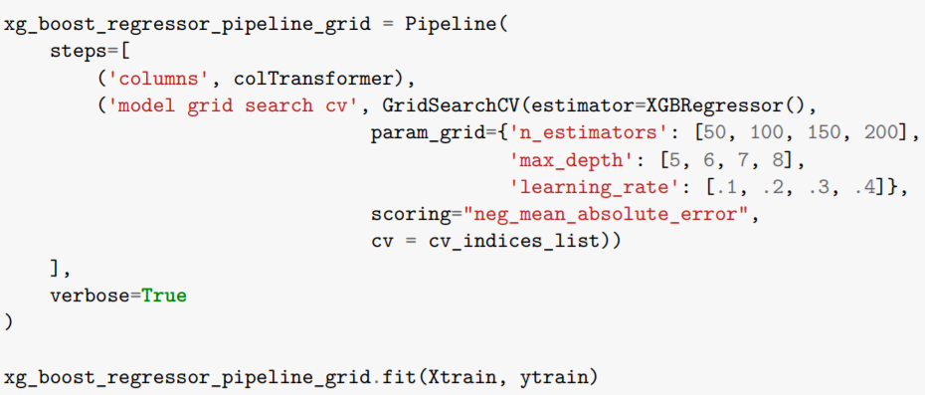
Hyperparameter Optimization
Vary parameters
n_estimators
max_depth
Learning_rate
Improve performance by .1
13.95 -> 13.87
insignificant

Slide 17
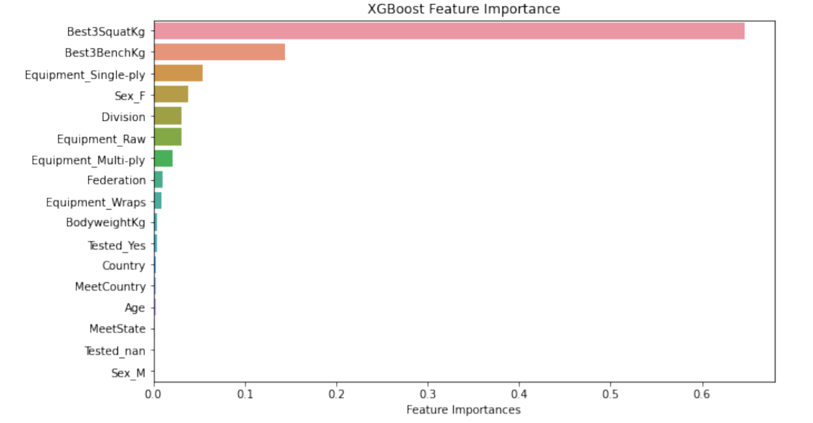
Feature Selection
Try for same performance with fewer features
17 -> 10
XGBoost Feature Importance
Lasso Regression
Permutation Importance
All similar story
41% faster preprocessing
20% fit time
13.96 MAE (was 13.87)

Slide 18
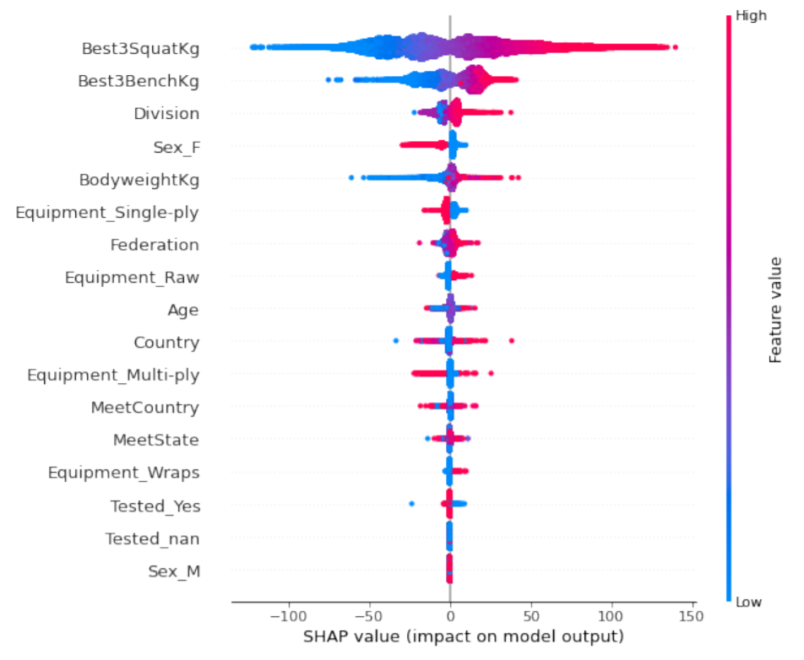
Interpretation
Shapley Values
High shapley -> high deadlift
Model agnostic
Good visuals

Slide 19
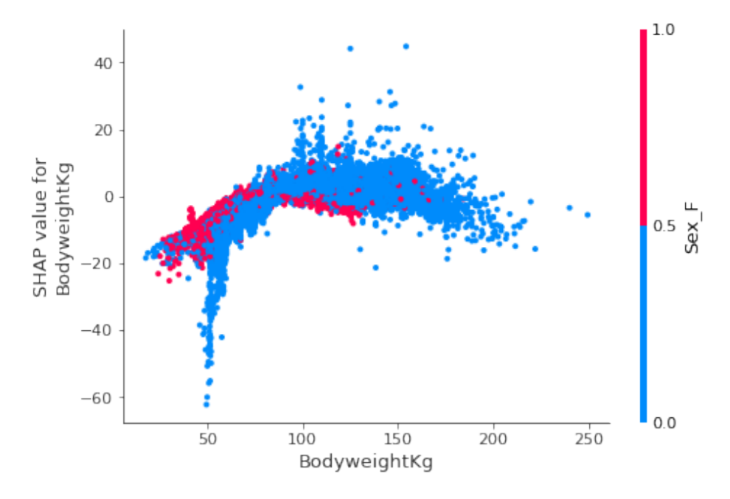
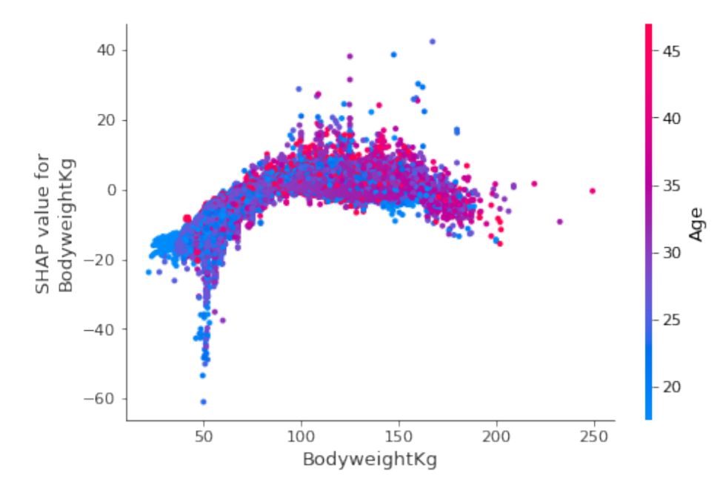
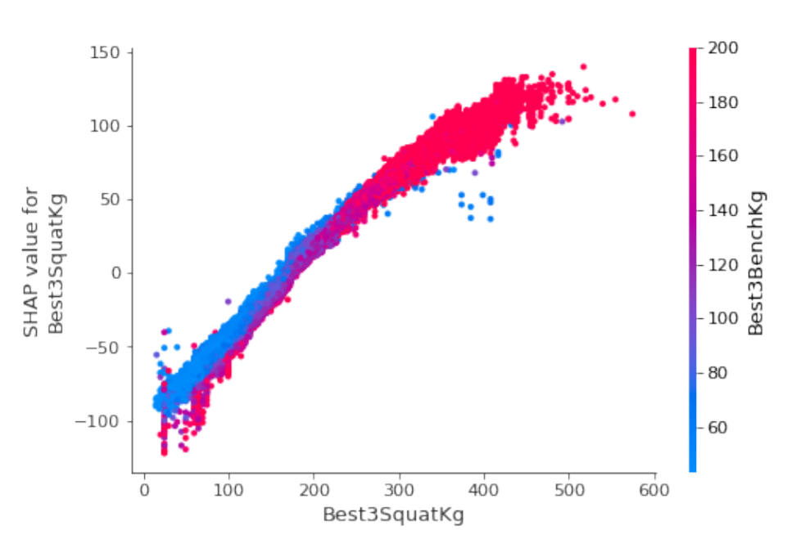
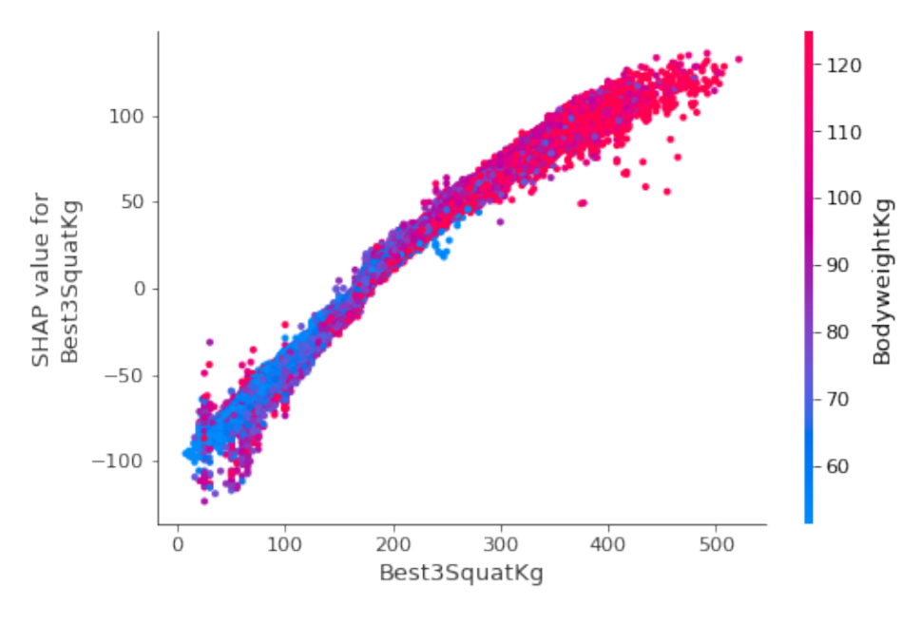
Interpretation
Partial Dependence Plots
Deadlift vs 2 other features

Slide 20
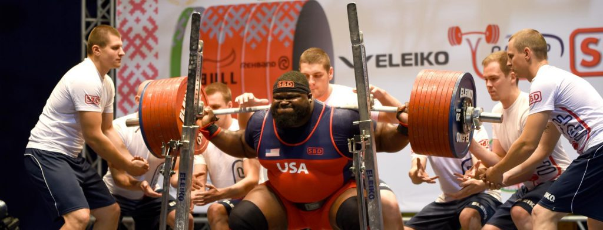
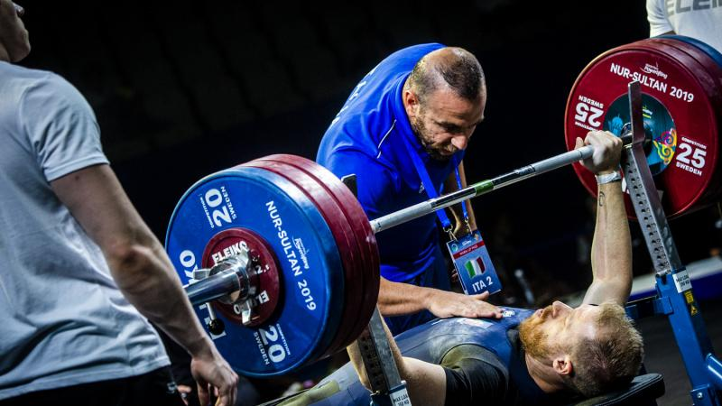
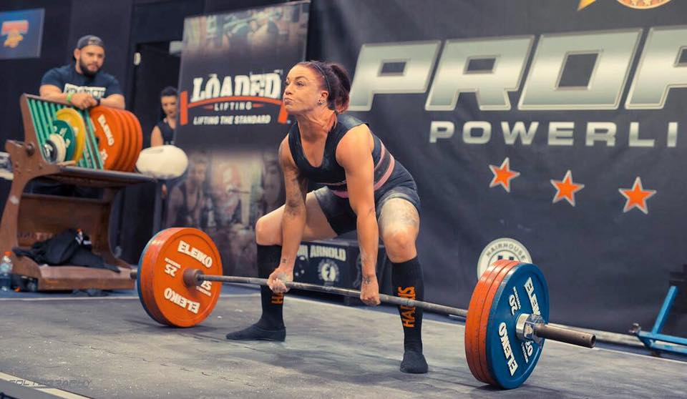
Conclusion
Other lifts matter the most
Division, sex, and bodyweight are important, too
Drug testing didn’t seem to matter much after all
XGBoost worked best
~14 kg average error
Shapley values are awesome

